Slide 1
Parent Meeting
Set 1 Sounds
Notes:
Approximately 20 minutes is needed for this session.
Notes are provided to help you lead the presentation.
Notes in italics are for your attention only.
This bitesize parent session is best used alongside a demo lesson of teaching a Set 1 sound to children. Alternatively, you may wish to use an in-action film from the Online subscription.
Provide copies of ‘Reading at Home Booklet 1’ from Oxford Owl for each parent.

Slide 2
English alphabetic code
44 sounds
26 letters
Over 150+ graphemes (letter combinations)
One of the most complex alphabetic codes in the world.
Notes:
We use 44 sounds to make all the words in the English language.
This means we’ve got a problem.
Click. We’ve got 44 sounds and only 26 letters.
The 26 letters work singly, in pairs and sometimes in threes to represent one sound.
We have to group letters together to write some sounds e.g. ‘igh’, ‘air’.
In English we have more than 150 ways to represent 44 sounds, using the 26 letters in the alphabet.
Click. This makes our language one of the most complex in the world!

Slide 3
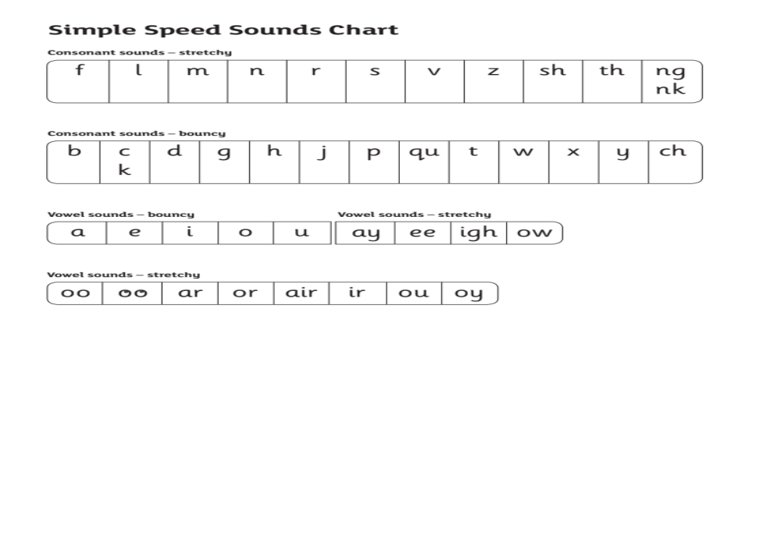
Speed Sounds Set 1
Notes:
Children need to know sounds – not letter names – to read words.
We say the sounds in a way to make them easy to blend into a word.
We aim to eliminate the ‘uh’ at the end of the sound. This is called a ‘schwa’ sound.
We say ‘c’ ‘a’ ‘t’ rather than cuh a tuh.
Use MTYT to teach each of the Set 1 sounds to parents.

Slide 4

‘Same, same!’
Notes:
We – children and adults - always connect new learning to something we already know.
This is why in Read Write Inc. we make the connections for the children. We help them hold onto that connection so they don’t forget at the end of each lesson.
We give children a hook to learn the sounds by using pictures in the same shape as the letter.
‘s’ looks like a snake.
‘d’ looks like a dinosaur.
‘m’ looks like a mountain.
‘a’ looks like an apple.
We teach the children to name the mnemonic pictures before they learn the sound.
This means that children learn to read and write the sounds really easily.

Slide 5
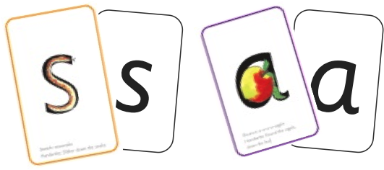


Sounds + blending = word reading
+
=
Notes:
When children can read sounds speedily, like this, (show how speedily this needs to be) and understand Fred (m-a-t...mat) (click), they can decode words.

Slide 6
How do I use the Virtual Classroom?
Set aside 10 minutes to watch a film with your child each day.
Find a quiet space for your child to watch the film on a laptop or tablet.
Praise your child as they join in with the lesson – make it fun!
The more they practise using these films, the quicker they’ll learn to read.
Notes:
We will send you links to the films via email/ upload links to Google classroom/ Class Dojo etc.
When you receive the link, simply click on it . . . and press play.
Set aside 10 minutes to watch a film with your child each day.
Find a quiet space for your child to watch the film on a laptop or tablet.
Praise your child as they join in with the lesson – make it fun!
The more they practise using these films, the quicker they’ll learn to read.

Slide 7
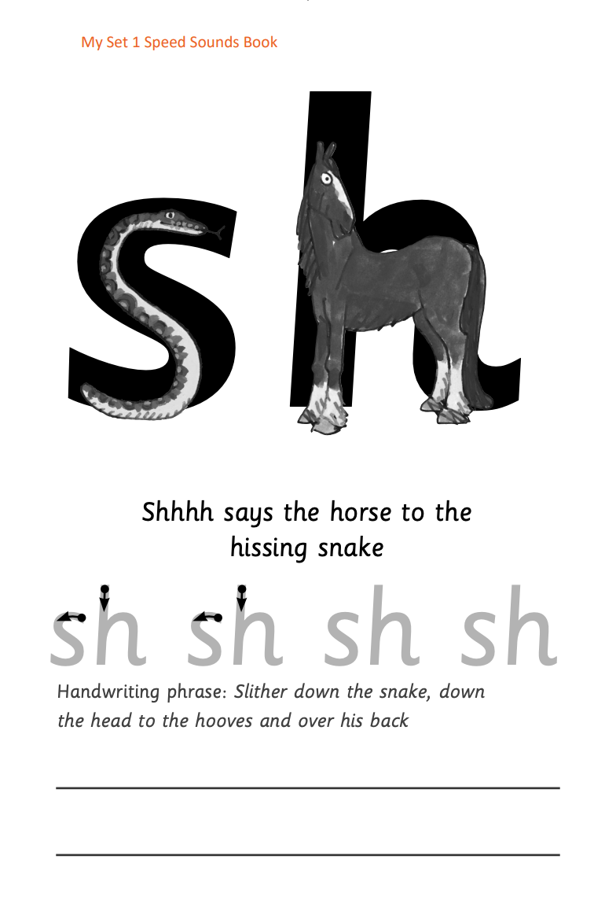






Practice at home
Notes:
Discuss the one that is applicable to your school:
Your child will also bring home a My Set 1 Speed Sounds books to practise reading and writing the Set 1 sounds
There are instructions for you inside cover of the book.
Each week, your child will bring home the Speed Sounds cards they have been taught to practise reading sounds speedily.
You can purchase Set 1 flashcards or My Reading and Writing Kit ages 3-5 early sounds and blending to support your child with Set 1 sounds at home if you wish.

Slide 8
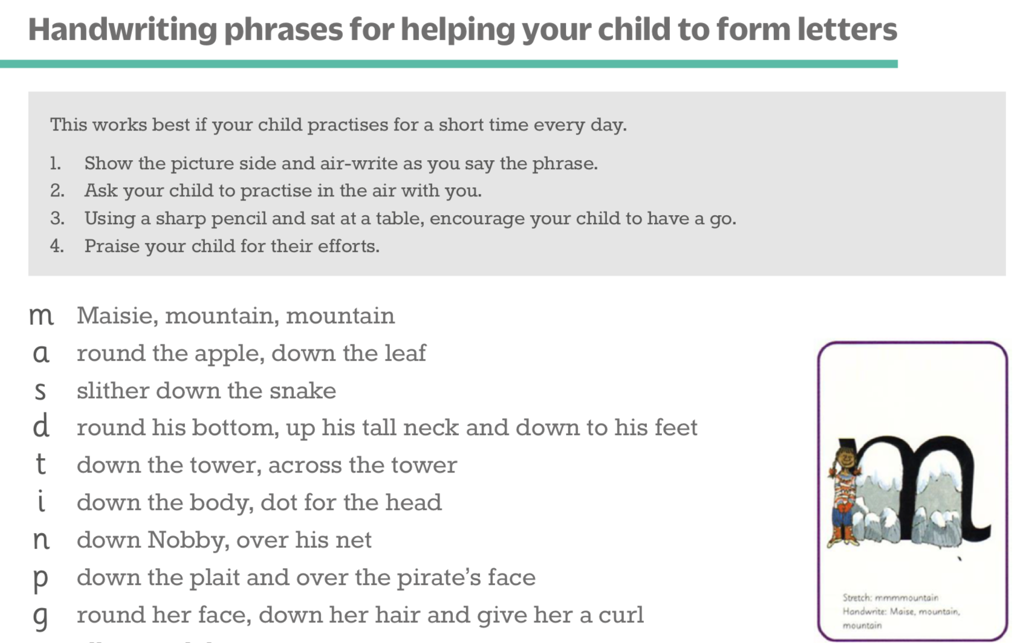
Teaching letter formation
Notes:
Alongside learning to read each sound, children use a handwriting phrase linked to the picture mnemonic to learn to form each letter correctly.
e.g. down Maisie, and over the mountains.
Use these handwriting phrases when practising writing at home with your child.
Avoid using these to read the sound.
I will give you a handout of these handwriting phrases when you leave today.

Slide 9
What can I do?
Use pure sounds rather than letter names.
Teach the picture names.
Practise reading sounds speedily.
Watch the Virtual Classroom films together.
Use the handwriting phrases to practise writing.
Notes:
1. Use pure sounds rather than letter names.
2. Teach the picture names.
3. Practise reading sounds speedily.
4. Watch the Virtual Classroom films together.
5. Use the handwriting phrases to practise writing.

Slide 10
Online resources available
Ruth Miskin Parents’ Page:
https://www.ruthmiskin.com/parents/
Ruth Miskin Facebook:
https://www.facebook.com/miskin.education
Free e-books for home reading:
http://www.oxfordowl.co.uk/Reading/

Slide 11

Any questions?

